Slide 1
Anubaad : A Machine Learning Approach to Recognize Bangla Sign Language
Md. Mehedi Hasan
ID : 221-15-5976
Department : CSE
Daffodil International University

Slide 2
Outline
Introduction
Problem Statements
Motivation
Objective
Background Study
Comparison Between Existing Works
Gap Analysis
Methodology
Sample Dataset
Expected Output
Web Interface
Results & Analysis
Novelty of the Work
Conclusion
References

Slide 3
Introduction
Sign language is a technique that uses a variety of hand movements to share ideas. People who can't speak often use sign language to express their feelings.
By using a variety of machine learning techniques, I tried to recognize this hand gestures of Bengali sign language and translate it into text and speech for this project.

Slide 4
Problem Statement
Communication barriers: Deaf individuals face challenges in interacting with hearing people due to limited human sign language interpreters.
Existing issues in BdSL detection: Variability in gestures, environmental factors (lighting), limited datasets, and low real-time performance.
Specific challenges: Many systems achieve high accuracy in controlled settings but fail in dynamic, real-world scenarios

Slide 5
Motivation
We see many people around us who cannot speak, who cannot express their feelings properly, so i have decided to create this project, keeping in mind that these mute people who cannot speak can express their feelings with ordinary people. Through this, I believe that it is possible to eliminate the gap between ordinary people and these disabled mutes in our society.

Slide 6
Objective
The primary objective of this project is to develop a real-time Sign Language Detection System using machine learning techniques(CNN, MobileNetV2, VGG16, SVM, Random Forest etc) to bridge communication barriers between hearing-impaired individuals and the broader community.

Slide 7
Background Study
Chowdhury et al. (2021) employed Artificial Neural Networks (ANNs) and Support Vector Machines (SVMs) for BdSL detection, achieving a maximum accuracy of 84.11% [1]. Some students from Carleton University published a paper in 2020 titled 'A Deep Learning Approach for Recognizing Bengali Character Sign Language', in which they used CNN to train 5,760 preprocessed images and achieved 92.7% accuracy [2]. Shanta et al. (2018) explored BdSL detection using SHIFT and CNNs, focusing on 36 signs representing BdSL. The study did not specify the achieved accuracy [3]. Urmee et al. (2019) developed a BdSL to Text- Speech Translator using CNNs, achieving 98.93% accuracy [4]. Talukder et al. (2020) implemented real-time BdSL detection with sentence and speech generation using YOLOv4, achieving 97.95% accuracy [5]. Haque et al. (2018) utilized Faster R-Convolutional Neural Networks (CNNs) for BdSL detection, reporting an accuracy of 98.2% [6]. Hasan et al. (2016) developed a BdSL detection system using Histogram of Oriented Gradients (HOG), SVM, Text-to-Speech (TTS), and K-NN, achieving an accuracy of 86.53% [7].

Slide 8
Comparison Between Existing Works
Study | Model/Approach | Accuracy | Limitations
Shanta et al. (2018) | SHIFT, CNNs (BdSL, 36 signs) | Not specified | Accuracy not Mentioned.
Urmee et al. (2019) | CNNs (BdSL to Text-Speech) | 98.93% | High accuracy but may face challenges in real-time processing.
Haque et al. (2018) | Faster R-CNN (BdSL) | 98.2% | Computationally intensive; may struggle with real-time performance.
Talukder et al. (2020) | YOLOv4 (BdSL, Real-Time with Sentence/Speech) | 97.95% | High accuracy but complex model; may face challenges in low-resource environments.
Hossein et al. (2020) | Novel Deep CNN (BdSL) | 99.96% | Exceptionally high accuracy; potential overfitting risk or limited testing on diverse datasets.
Saquib et al. (2020) | CNNs, Wearable Sensors (BdSL) | 96% | Dependency on wearable sensors.
Chowdhury et al. (2021) | ANN, SVM (BdSL) | 84.11% | Lower accuracy;

Slide 9
Gap Analysis
Features | Existing Research | Proposed Research
Recognize Sign Language | Yes | Yes
Data Augmentation | Yes | Yes
Landmarks Detection | No | Yes
Real Time Detection | Yes | Yes
Word Formation | No | Yes
Audio Output | No | Yes
Lightweight Model | No | Yes
B.Sc. Final-Defense

Slide 10
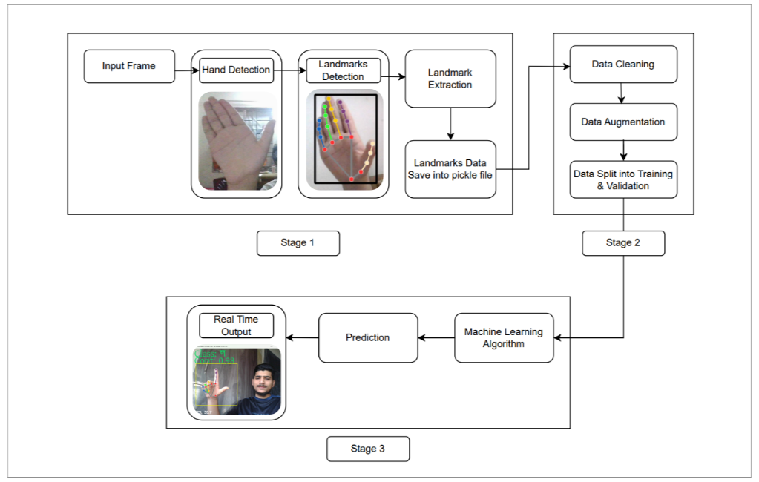
Methodology

Slide 11
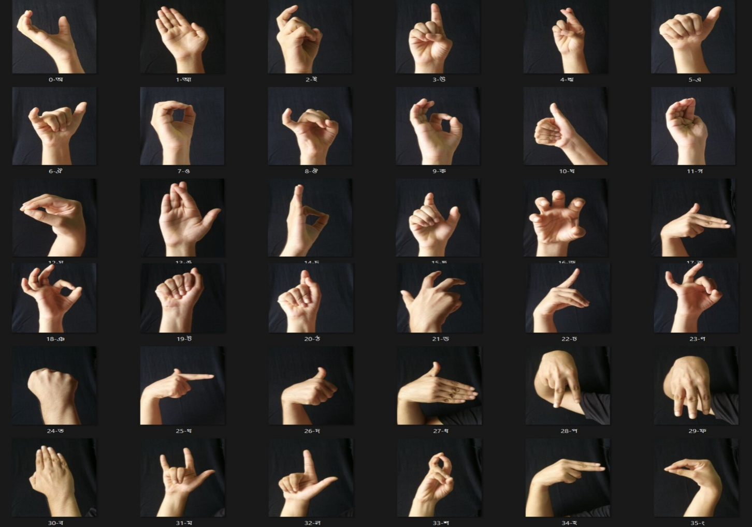
Sample Dataset
Sample Dataset

Slide 12
Expected Output
Real Time Detection
Audio Output
Word Formation

Slide 13
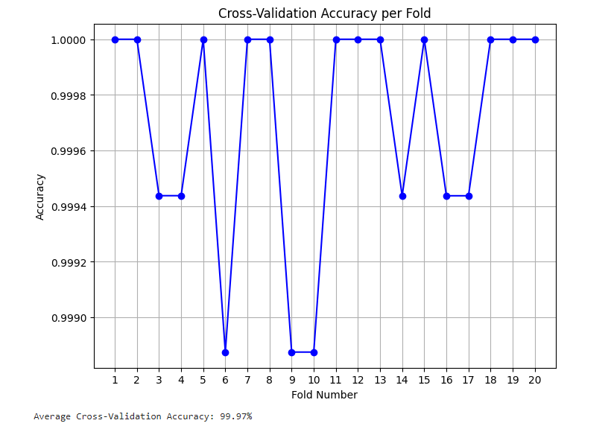
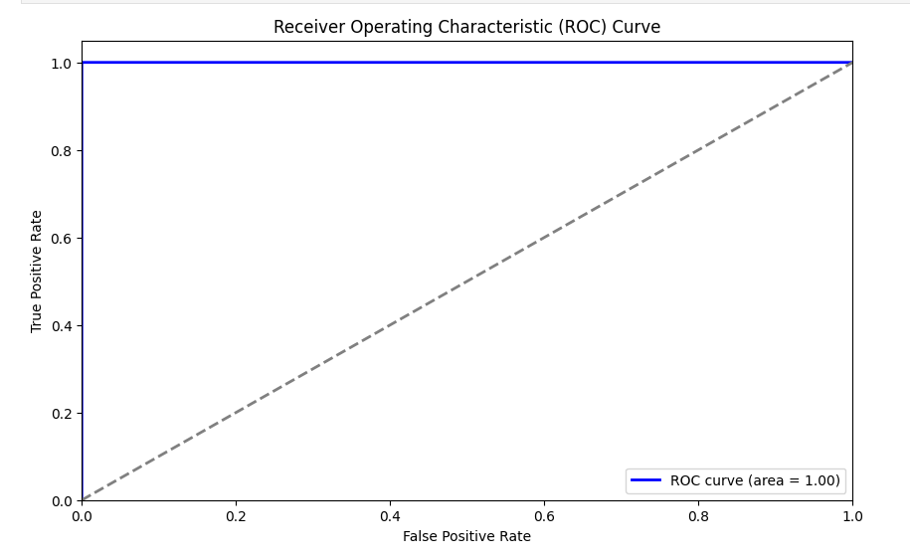
Result and Analysis
ROC Curve
Cross-Validation Accuracy Graph

Slide 14
Novelty of the Work
Real Time Sign Language Detection
High Accuracy
Word Formation & Generate Audio

Slide 15
Conclusion
The summary of my project is that my project receives various hand gestures as input through the camera in real time and generates output in real time based on the way it has been trained and this whole work is completed in less than 1 second. I had to follow many steps to complete this project such as Data Collection, Data Preprocessing, Features Extraction, Model Selection, Model Training, Real time detection. I think this project of mine will help the Deaf Community people in real life.

Slide 16
References
R. Chowdhury, A. Biswas, S. M. F. Hasan, T. M. Rahman, and J. Uddin, “Bengali sign language to text conversion using artificial neural network and support vector machine,” in 2017 3rd International Conference on Electrical Information and Communication Technology (EICT), 2017, pp. 1–4.
Carleton University, "A Deep Learning Approach for Recognizing Bengali Character Sign Language," in 2020 11th ICCCNT 2020 July 1-3, 2020 - IIT - Kharagpur, India. pp. 1-6.
S. S. Shanta, S. T. Anwar, and M. R. Kabir, “Bangla sign language detection using sift and cnn,” in 2018 9th International Conference on Computing, Communication and Networking Technologies (ICCCNT), 2018, pp. 1–6.
P. P. Urmee, M. A. A. Mashud, J. Akter, A. S. M. M. Jameel, and S. Islam, “Real- time bangla sign language detection using xception model with augmented dataset,” in 2019 IEEE International WIE Conference on Electrical and Computer Engineering (WIECON-ECE), 2019, pp. 1–5.
D. Talukder and F. Jahara, “Real-time bangla sign language detection with sentence and speech generation,” in 2020 23rd International Conference on Computer and Information Technology (ICCIT), 2020, pp. 1–6.
O. B. Hoque, M. I. Jubair, M. S. Islam, A.-F. Akash, and A. S. Paulson, “Real time bangladeshi sign language detection using faster r-cnn,” in 2018 International Conference on Innovation in Engineering and Technology (ICIET), 2018, pp. 1–6.
M. Hasan, T. H. Sajib, and M. Dey, “A machine learning based approach for the detection and recognition of bangla sign language,” in 2016 International Conference on Medical Engineering, Health Informatics and Technology (MediTec), 2016, pp. 1–5

Slide 17
THANK YOU

